Slide 1


Understanding “Wild”: How Nature is Presented in Video-Games Across Cultures
Aaryan Sukhadia

Slide 2
Guess the Game
Single-Player, Role-Playing Game
You play as a former knight in a medieval kingdom battling supernatural monsters
Tasked by the king to rescue his daughter with magical powers who has been kidnapped by a dark, ancient foe you once knew
Exploring and traversing nature is a central component of gameplay
Contains “wild” in the title
Won the Game Awards’ Game of the Year

Slide 3

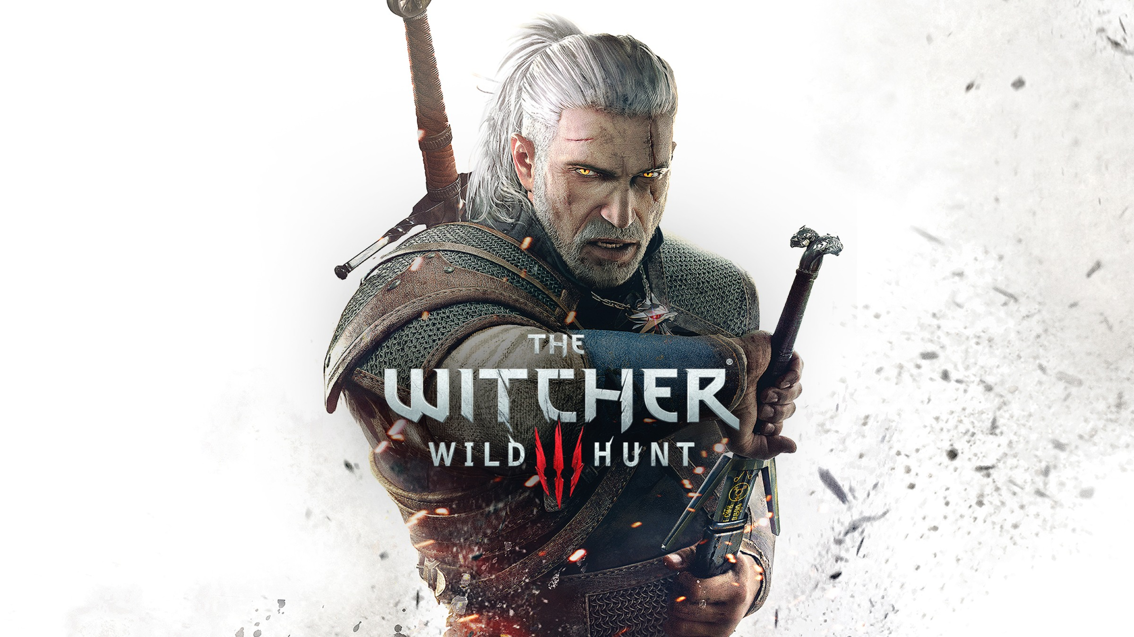
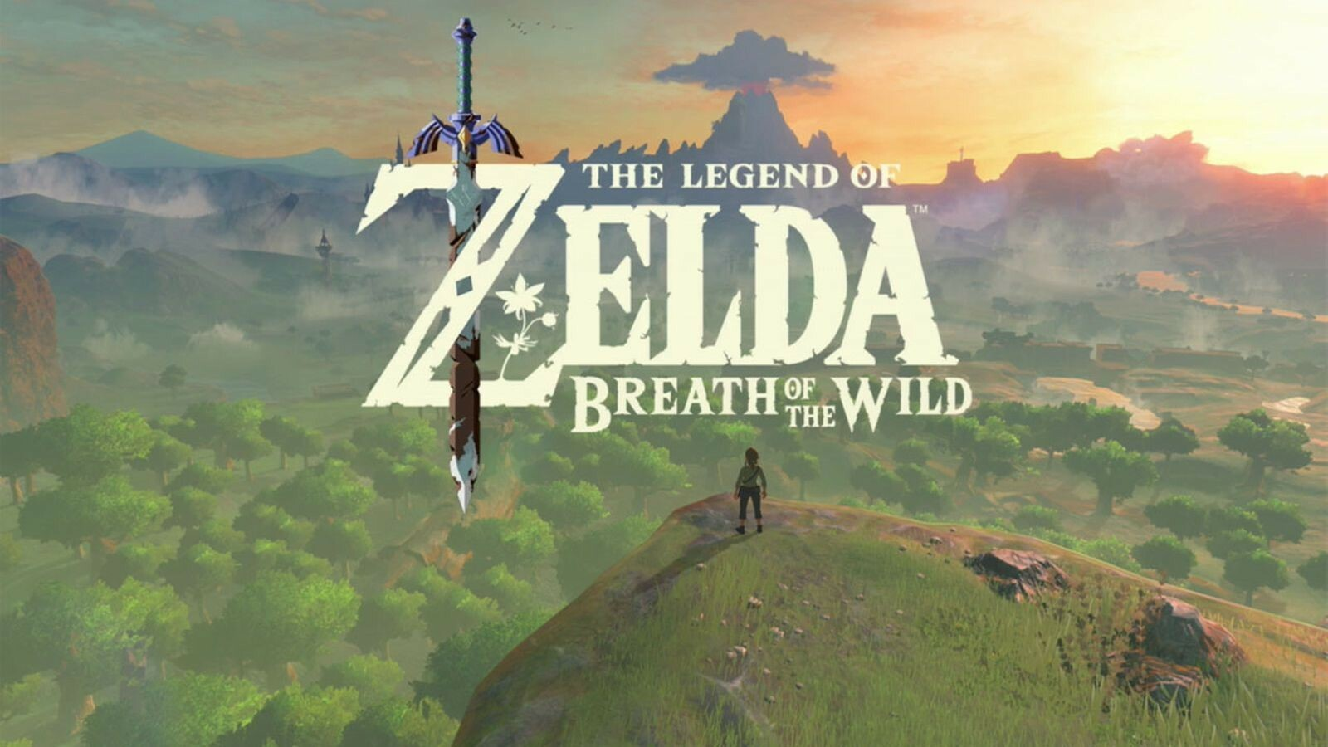
Trick Question!
TWO games fit that exact description!

Slide 4
What’s different?
The Witcher 3 | Breath of the Wild

Slide 5
What’s different?
The Witcher 3 | Breath of the Wild
Praised for Narrative and Characters | Praised for Exploration and World Design

Slide 6
What’s different?
The Witcher 3 | Breath of the Wild
Praised for Narrative and Characters | Praised for Exploration and World Design
Focus on Main Character’s Fate and Relations | Focus on Fate of Kingdom and World

Slide 7
What’s different?
The Witcher 3 | Breath of the Wild
Praised for Narrative and Characters | Praised for Exploration and World Design
Focus on Main Character’s Fate and Relations | Focus on Fate of Kingdom and World
Emphasis on moving through natural world | Emphasis on engaging with natural world

Slide 8
What’s different?
The Witcher 3 | Breath of the Wild
Praised for Narrative and Characters | Praised for Exploration and World Design
Focus on Main Character’s Fate and Relations | Focus on Fate of Kingdom and World
Emphasis on moving through natural world | Emphasis on engaging with natural world
Anthropocentrism
Prioritizing human comfort and wellbeing above all else

Slide 9
What’s different?
The Witcher 3 | Breath of the Wild
Praised for Narrative and Characters | Praised for Exploration and World Design
Focus on Main Character’s Fate and Relations | Focus on Fate of Kingdom and World
Emphasis on moving through natural world | Emphasis on engaging with natural world
Anthropocentrism
Prioritizing human comfort and wellbeing above all else
Ecocentrism
Prioritizing and valuing nature as equal to or above human luxuries

Slide 10
What’s different?
The Witcher 3 | Breath of the Wild
Praised for Narrative and Characters | Praised for Exploration and World Design
Focus on Main Character’s Fate and Relations | Focus on Fate of Kingdom and World
Emphasis on moving through natural world | Emphasis on engaging with natural world
Anthropocentrism
Prioritizing human comfort and wellbeing above all else
e.g. Western Capitalism
Ecocentrism
Prioritizing and valuing nature as equal to or above human luxuries

Slide 11
What’s different?
The Witcher 3 | Breath of the Wild
Praised for Narrative and Characters | Praised for Exploration and World Design
Focus on Main Character’s Fate and Relations | Focus on Fate of Kingdom and World
Emphasis on moving through natural world | Emphasis on engaging with natural world
Anthropocentrism
Prioritizing human comfort and wellbeing above all else
e.g. Western Capitalism
Ecocentrism
Prioritizing and valuing nature as equal to or above human luxuries
e.g. Japanese Shintoism

Slide 12
What’s different?
The Witcher 3 | Breath of the Wild
Praised for Narrative and Characters | Praised for Exploration and World Design
Focus on Main Character’s Fate and Relations | Focus on Fate of Kingdom and World
Emphasis on moving through natural world | Emphasis on engaging with natural world
Developed by CD Projekt Red in Poland | Developed by Nintendo in Japan
Anthropocentrism
Prioritizing human comfort and wellbeing above all else
e.g. Western Capitalism
Ecocentrism
Prioritizing and valuing nature as equal to or above human luxuries
e.g. Japanese Shintoism

Slide 13


Q: Are Japanese Games more Ecocentric than Western Games?

Slide 14

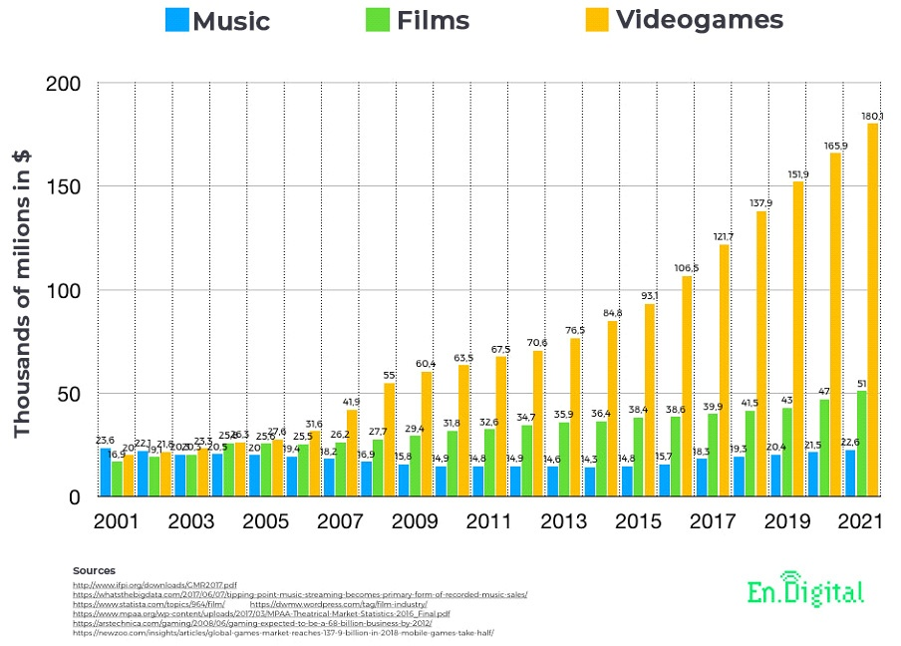

Why do we care?

Slide 15
Why do we care?
Video games are huge, and only growing

Slide 16
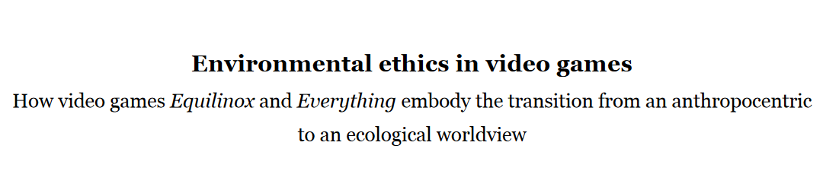
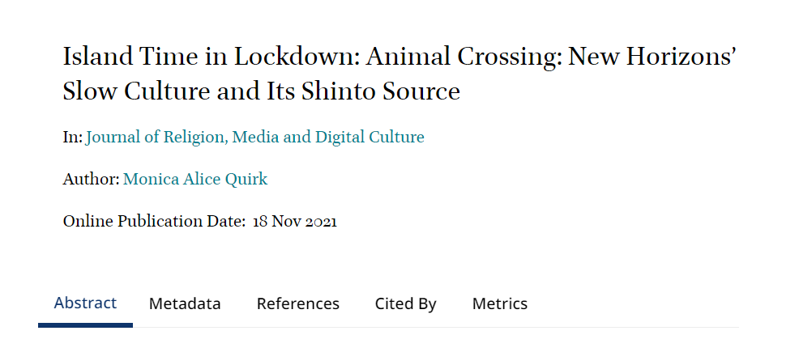
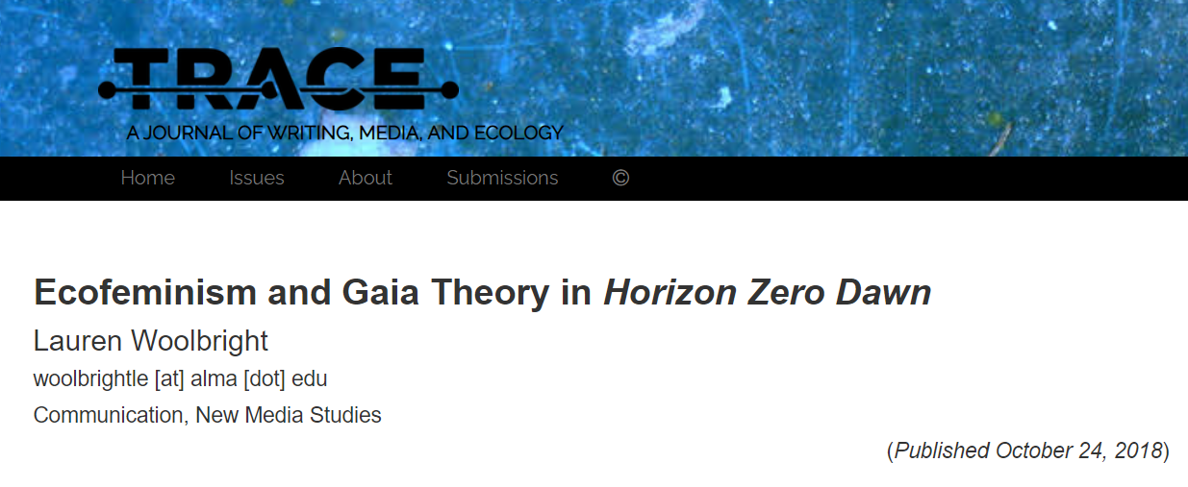
Why do we care?
Video games are huge, and only growing
Anthropocentric behavior in games correlates with anthropocentric mindset in real life (Vuong et al, 2022), (Rogers, 2018)
No such breadth-wise analysis exists

Slide 17
Why do we care?
Video games are huge, and only growing
Anthropocentric behavior in games correlates with anthropocentric mindset in real life (Vuong et al, 2022), (Rogers, 2018)
No such breadth-wise analysis exists

Slide 18


Q: Are Japanese Games more Ecocentric than Western Games?
Key idea: Analyze whether components of the game are ecocentric or anthropocentric
Our Case Study
(Mostly) Anthropocentric
Developed in Poland
Western Capitalism
(Mostly) Ecocentric
Developed in Japan
Japanese Shintoism
Nature is a commodity! The free market will solve everything!
Build more forest shrines! Give offerings to nature spirits!
vs

Slide 19


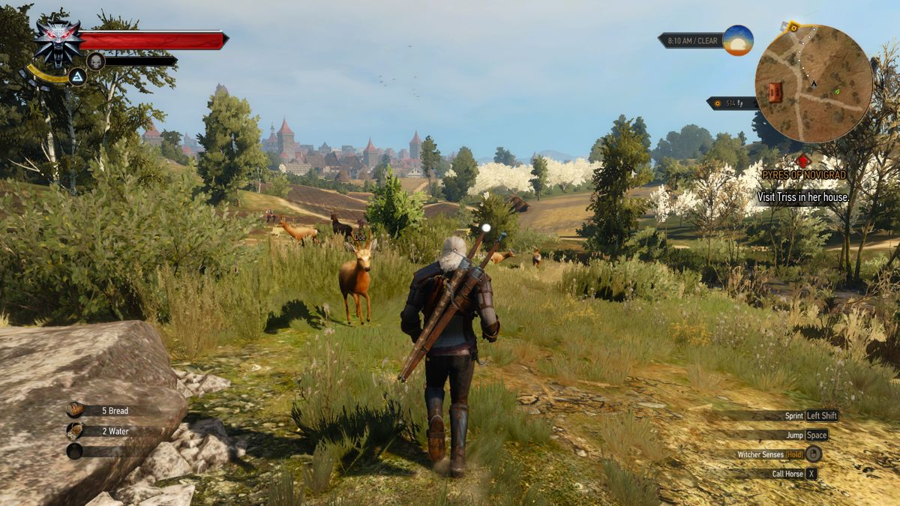
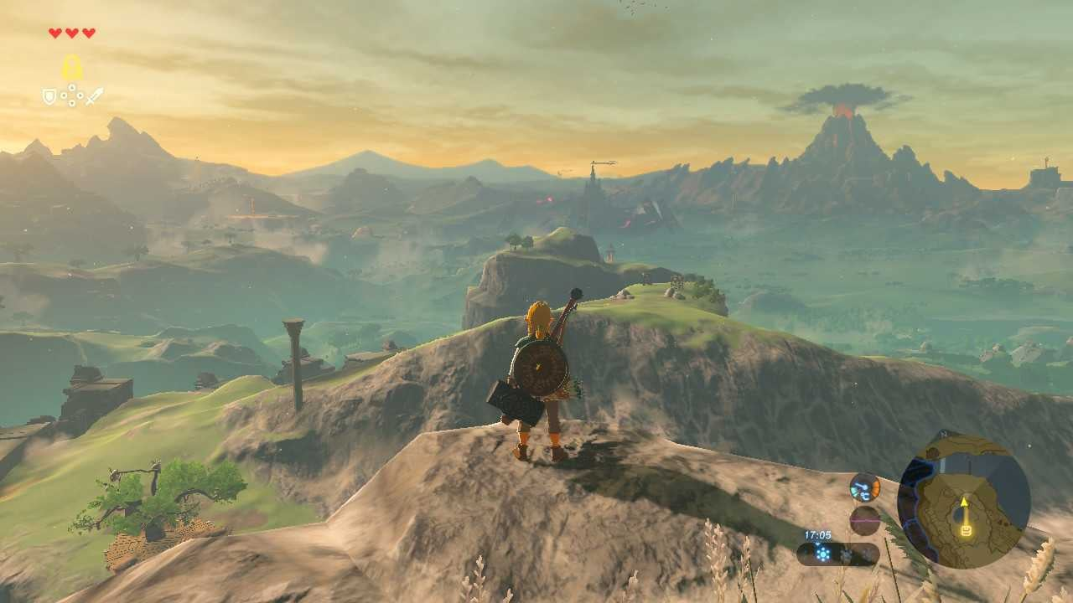
Q: Are Japanese Games more Ecocentric than Western Games?
Our Case Study
(Mostly) Anthropocentric
Developed in Poland
Western Capitalism
(Mostly) Ecocentric
Developed in Japan
Japanese Shintoism
Nature is a commodity! The free market will solve everything! (
Build more forest shrines! Give offerings to nature spirits!
vs
On-Screen Space
The Witcher 3: Anthropocentric
Breath of the Wild: Ecocentric
Image via Ganker
Image via Nintendo

Slide 20
Our Case Study
(Mostly) Anthropocentric
Developed in Poland
Western Capitalism
(Mostly) Ecocentric
Developed in Japan
Japanese Shintoism
Nature is a commodity! The free market will solve everything!
Build more forest shrines! Give offerings to nature spirits!
vs
On-Screen Space
The Witcher 3: Anthropocentric
Breath of the Wild: Ecocentric
Image via Ganker
Image via Nintendo

Slide 21
On-Screen Space
Breath of the Wild: Ecocentric
The Witcher 3: Anthropocentric
Image via Nintendo
Image via Ganker

Slide 22
On-Screen Space
The Witcher 3: Anthropocentric
Breath of the Wild: Ecocentric
Image via Ganker
Image via Nintendo

Slide 23
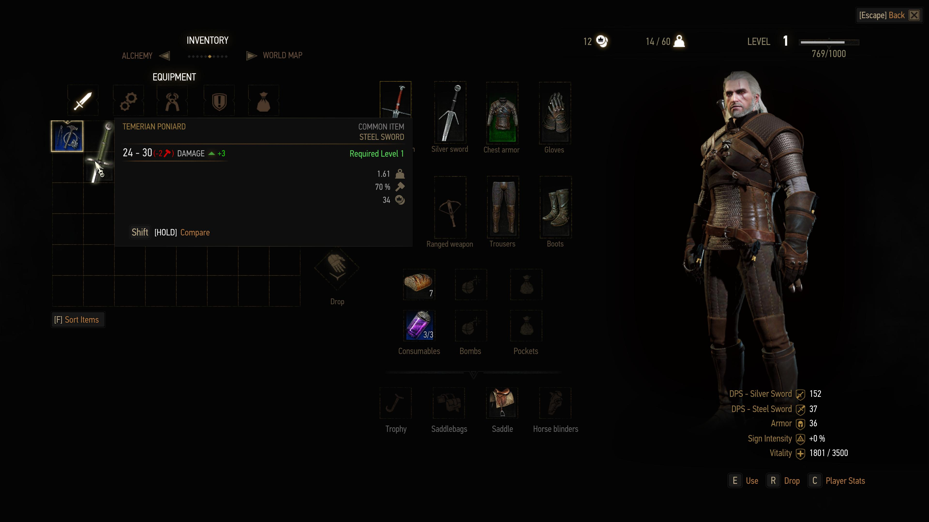
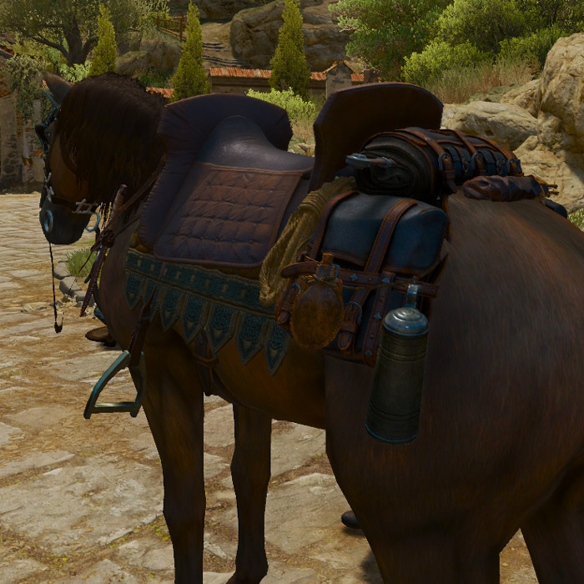
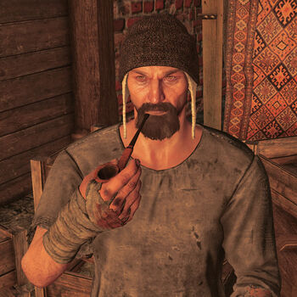
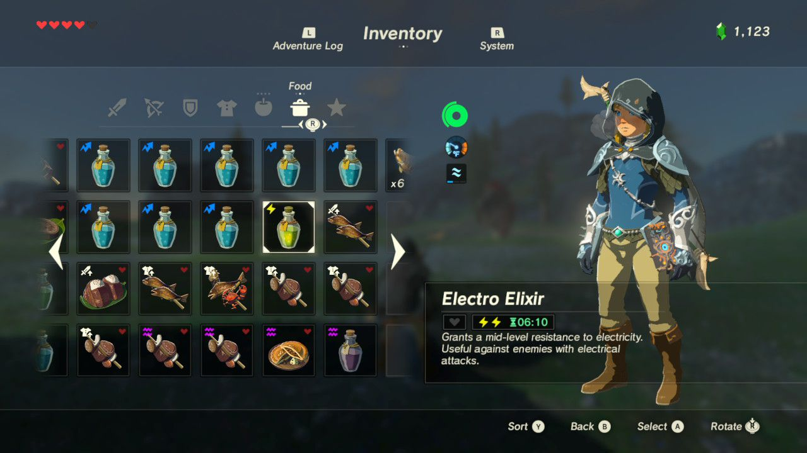
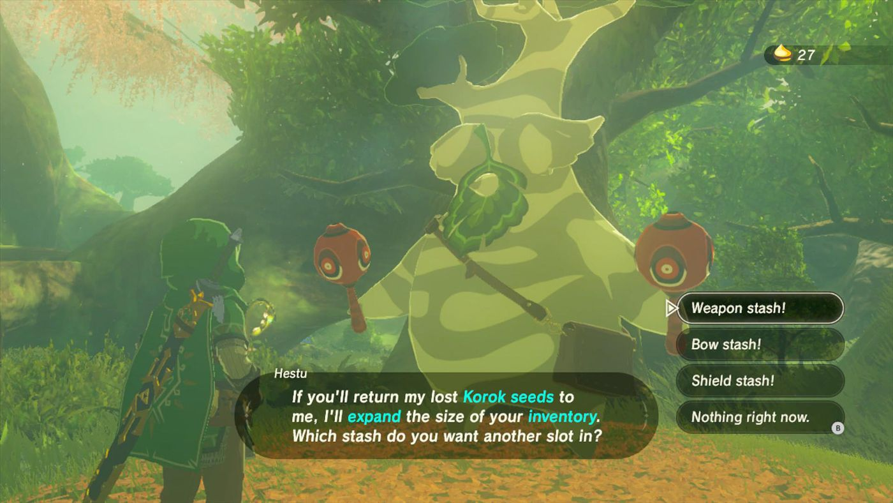
Inventory Management
On-Screen Space
The Witcher 3: Anthropocentric
Breath of the Wild: Ecocentric
Image via Ganker
Image via Nintendo
The Witcher 3
Breath of the Wild
Image via WitcherWiki
Image via Nintendo

Slide 24
Inventory Management
On-Screen Space
The Witcher 3: Anthropocentric
Breath of the Wild: Ecocentric
Image via Ganker
Image via Nintendo
The Witcher 3: Anthropocentric
Breath of the Wild: Ecocentric
Image via WitcherWiki
Image via Nintendo

Slide 25
Inventory Management
Breath of the Wild
The Witcher 3: Anthropocentric
Image via Nintendo
Image via WitcherWiki

Slide 26

Inventory Management
Breath of the Wild
The Witcher 3: Anthropocentric
Image via Nintendo
Image via WitcherWiki

Slide 27
Inventory Management
The Witcher 3
Breath of the Wild: Ecocentric
Image via WitcherWiki
Image via Nintendo

Slide 28
Inventory Management
The Witcher 3: Anthropocentric
Breath of the Wild: Ecocentric
Image via WitcherWiki
Image via Nintendo

Slide 29
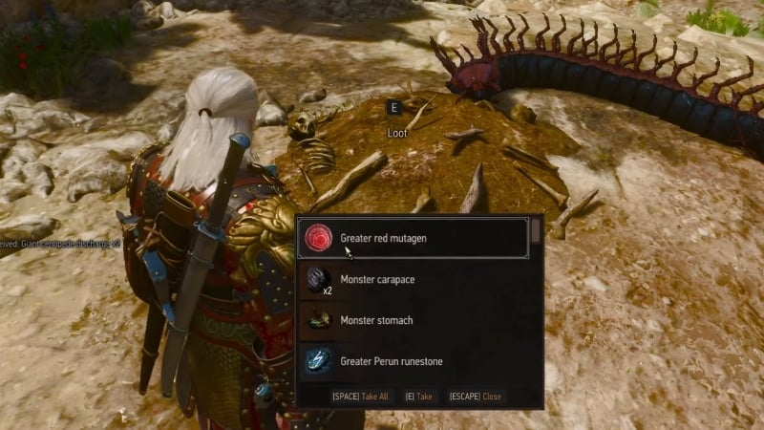
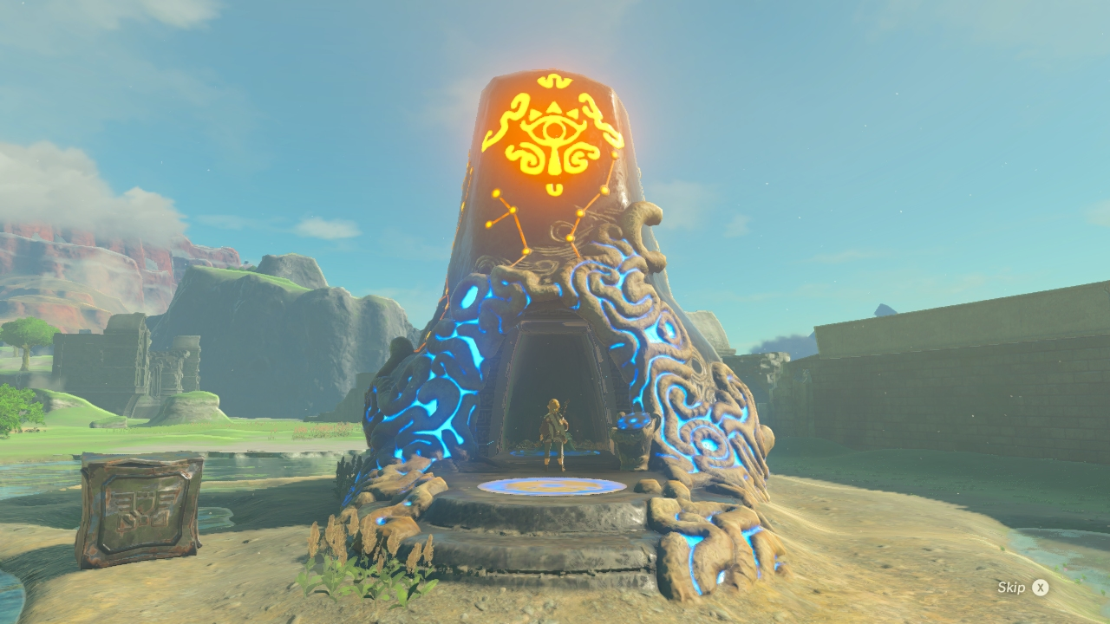
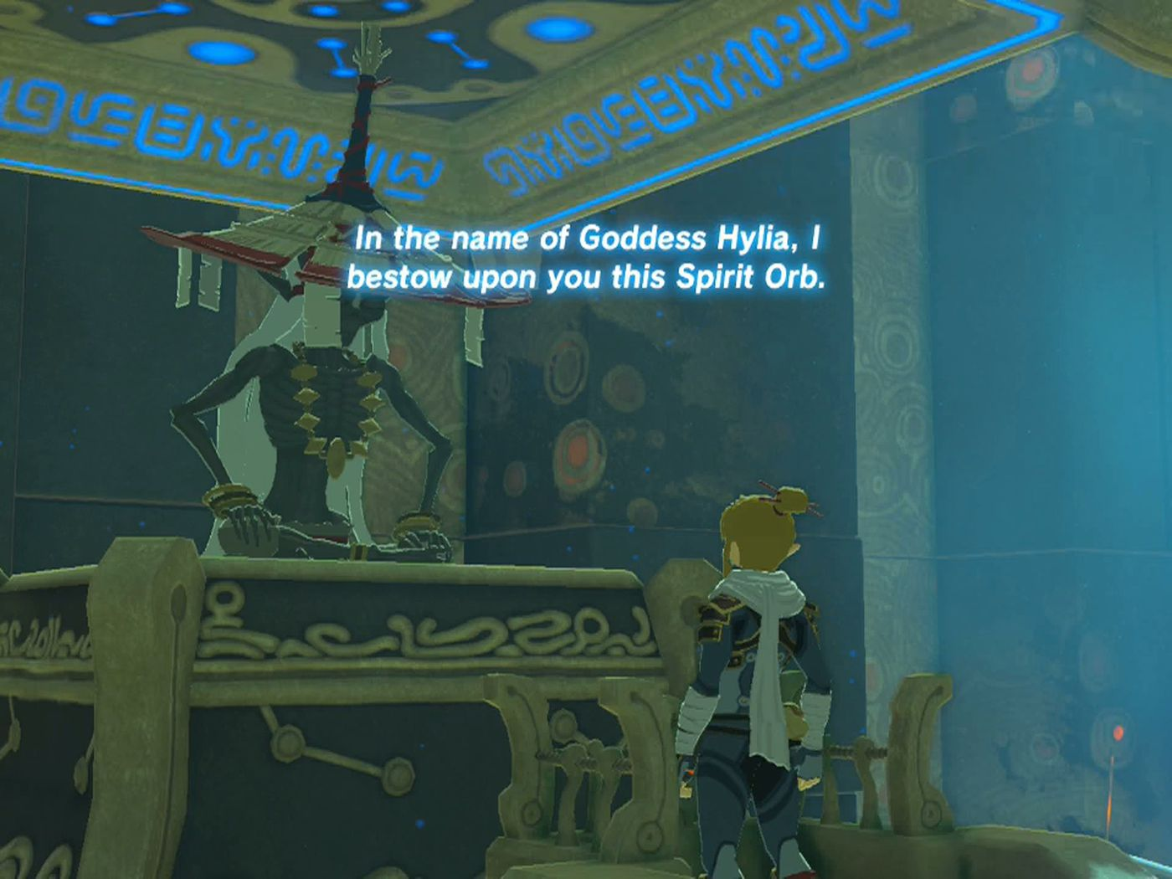
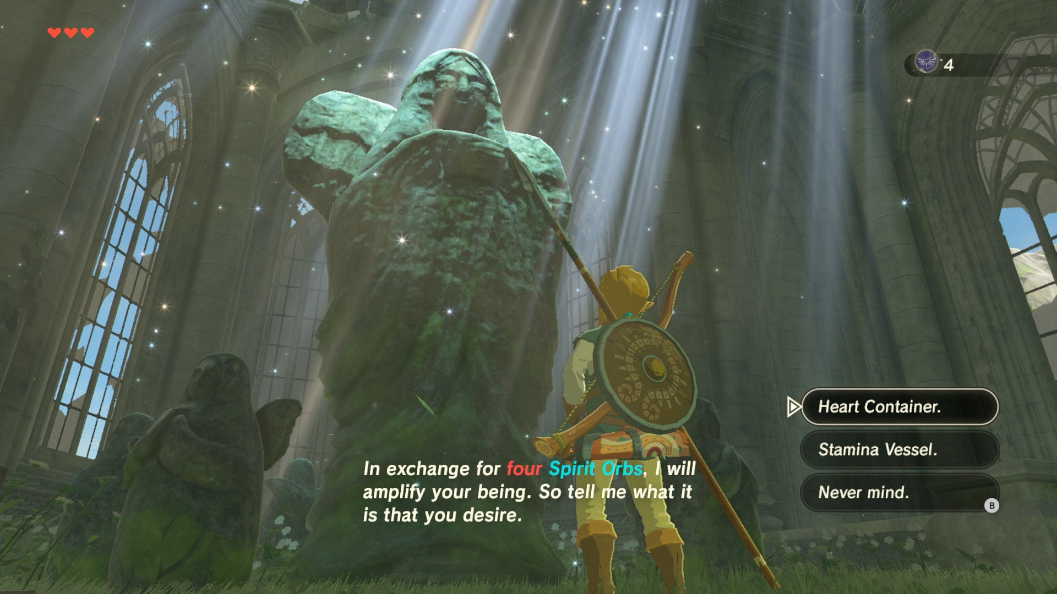
Inventory Management
The Witcher 3: Anthropocentric
Breath of the Wild: Ecocentric
Image via WitcherWiki
Image via Nintendo
Increasing Health
The Witcher 3: Anthropocentric
Breath of the Wild: Ecocentric
Image via NerdStash
Images via Polygon and IGN

Slide 30
Increasing Health
The Witcher 3: Anthropocentric
Breath of the Wild: Ecocentric
Image via NerdStash
Images via Polygon and IGN

Slide 31
Increasing Health
Breath of the Wild: Ecocentric
The Witcher 3: Anthropocentric
Images via Polygon and IGN
Image via NerdStash

Slide 32
Increasing Health
The Witcher 3: Anthropocentric
Breath of the Wild: Ecocentric
Image via NerdStash
Images via Polygon and IGN

Slide 33
Increasing Health
The Witcher 3: Anthropocentric
Breath of the Wild: Ecocentric
Image via NerdStash
Images via Polygon and IGN

Slide 34
Increasing Health
The Witcher 3: Anthropocentric
Breath of the Wild: Ecocentric
Image via NerdStash
Images via Polygon and IGN

Slide 35
Increasing Health
The Witcher 3: Anthropocentric
Breath of the Wild: Ecocentric
Image via NerdStash
Images via Polygon and IGN
Our Case Study
(Mostly) Anthropocentric
Developed in Poland
Western Capitalism
(Mostly) Ecocentric
Developed in Japan
Japanese Shintoism

Slide 36
Increasing Health
The Witcher 3: Anthropocentric
Breath of the Wild: Ecocentric
Q: Are Japanese Games more Ecocentric than Western Games?
Image via NerdStash
Images via Polygon and IGN
Our Case Study
(Mostly) Anthropocentric
Developed in Poland
Western Capitalism
(Mostly) Ecocentric
Developed in Japan
Japanese Shintoism
Image via Ganker
Image via Nintendo

Slide 37
Q: Are Japanese Games more Ecocentric than Western Games?

Slide 38
Q: Are Japanese Games more Ecocentric than Western Games?
Analyze These Components: On-Screen Space; Inventory; Stats; Animals; Exploration of Nature; Enemies; Soundscape; Narrative Themes; “Slow-Gaming”; (Navarro-Remesal 2019)
Across These Games (Top 50 Best-Sellers and GOTY Winners)
Western: Minecraft, Read Dead Redemption 2, Terraria, Witcher 3, Skryim, God of War, Dragon Age
Japanese: Pokémon (6 games), Animal Crossing, Breath of the Wild, Elden Ring
Determine (Broadly) Ecocentric or Anthropocentric (for each game)

Slide 39
Results
More Anthropocentric | More Ecocentric
The Witcher 3: Wild Hunt | The Legend of Zelda: Breath of the Wild
The Elder Scrolls V: Skyrim | Elden Ring
Dragon Age: Inquisition | God of War
Red Dead Redemption 2 | Animal Crossing: New Horizons
Terraria | Pokémon (All 6 Games)
 | Minecraft

Slide 40
Results
More Anthropocentric | More Ecocentric
The Witcher 3: Wild Hunt | The Legend of Zelda: Breath of the Wild
The Elder Scrolls V: Skyrim | Elden Ring
Dragon Age: Inquisition | God of War
Red Dead Redemption 2 | Animal Crossing: New Horizons
Terraria | Pokémon (All 6 Games)
 | Minecraft
Emboldened: Western | Underlined: Japanese
Conclusion: Popular Japanese games are more ecocentric;
Popular Western games are more anthropocentric

Slide 41
“I think inside every adult is the heart of a child, and we just gradually convince ourselves we have to act more like adults”
- Shigeru Miyamoto, creator of Zelda

